Slide 1
Fake review detection using Data Mining techniques
14A8

Slide 2
TOC
Abstract
Problem Statement
Research objective
Proposed Framework
Implementations
Conclusion

Slide 3
Abstract
Reviews have become a valuable resource for decision making, however there are a lot of fake reviews creeping in, which tampers with the stable business model of an organization. Therefore fake review detection and removal has become an inevitable task in maintaining a business.

Slide 4
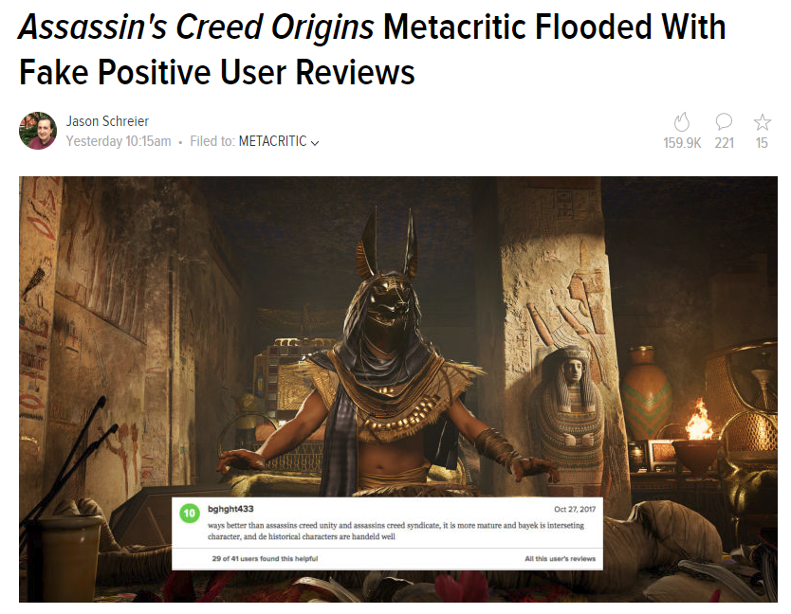
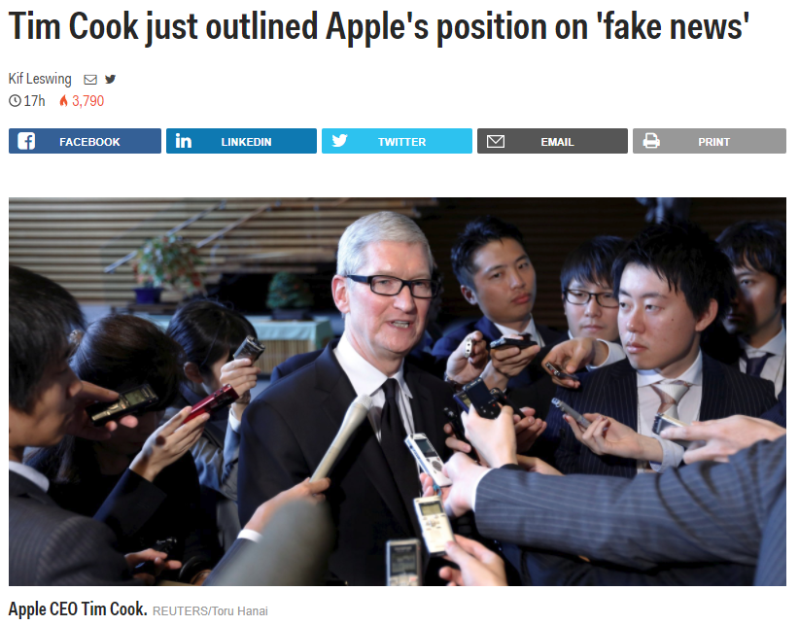
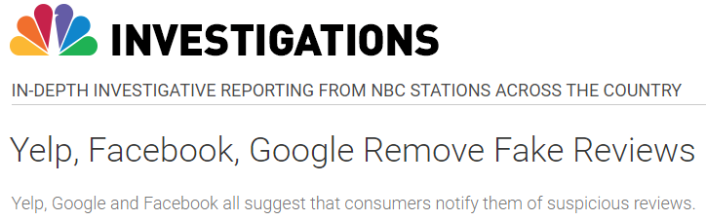

Slide 5
 | Paid Reviewer | Actual Reviewer
+ | the experience at the hard rock hotel in chicago was fantastic,i will rate them a 6 out of 5. they have wonderful service and great staff and the view is just wonderful. | I recently stayed at the Hard Rock Hotel in Chicago, Il. From the start, the experience was bad. The room was filthy, there were no towels, and the front desk did nothing to rectify the situation. I will never stay there again. I could not have been more dissatisfied.
- | The Swissotel Chicago is a very mediocre hotel, the service is always poor, and the room service food always comes cold, unless it's supposed to be cold than it comes warm. I would rather stay at a super 8 than this place again. | Uhhhhh, how do I know which direction to go in??? Stains on the carpet in the room. A big gouge in the wall, where maybe a thermostat once was??? The shower is decent. All in all, for the price they charge, NO THANKS!!! I'm just glad my company is footing the bill.

Slide 6
Problem Statement
01
Opinion spamming refers to various illegal activities like posting fake reviews, giving biased ratings, etc.
02
The review of the product can drastically affect its demand. So fake review detection is a must.

Slide 7
Research objective
Using sentiment analysis to analyse the sentiment of the reviews.
Applying N-gram categorization over the classification algorithm and compute the accuracy.

Slide 8
Related Work
[1] Myle Ott, Yejin Choi, Claire Cardie, Jeffrey T Hancock, 2011, Finding Deceptive Opinion Spam by Any Stretch of the Imagination
Standard text categorization (n-gram method)
Instance of psycho-linguistic deception detection.
[2] Myle Ott, Claire Cardie, Jeffrey T Hancock, 2013, Negative Deceptive Opinion Spam
Uses only negative deceptive reviews.
Compares human accuracy and n-gram based model.

Slide 9
Proposed framework
A comparative study between Labelled learning and unlabelled learning on the same data set..
Sentiment analysis over the data set using frequency distribution of words and classifier.

Slide 10
Frameworks used
Jupyter notebook
NLTK
Scikit-learn
Gensim
Data set provided by http://myleott.com/op-spam.html

Slide 11
Dataset
http://myleott.com/op_spam/
Corpus contains
400 truthful positive reviews from TripAdvisor
400 deceptive positive reviews from Mechanical Turk
400 truthful negative reviews from Expedia
400 deceptive negative reviews from Mechanical Turk
Files are named according to the format `%c_%h_%i.txt`, where:
%c denotes the class: (t)truthful or (d)deceptive
%h denotes the hotel

Slide 12
Sentiment Mining
Using the words in the review as features of either positive or negative review and then analysing the sentiment of the review.

Slide 13
Data Manipulation and Algorithm
Storing the tokenized words against the file-id of each review. The label of the review is also added.
Training Naive Bayes Classifier.
Testing the remaining tuples.

Slide 14
Output
The classifier is trained and tested to accurately predict the sentiment of the reviews with an accuracy of 75.44%.
The most commonly occurred words in the review is printed with it’s label and also the ratio of occurrence of the word in positive and negative reviews.

Slide 15
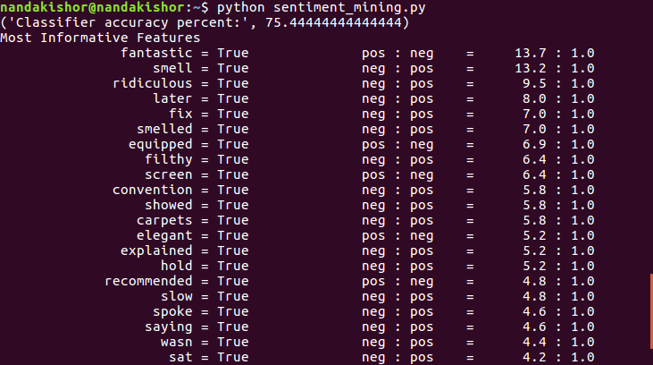
Output

Slide 16
Method-1 Using polarity of reviews
Polarity is the state of having two opposite or contradictory tendencies, opinions, or aspects.
Positive reviews and Negative reviews.

Slide 17
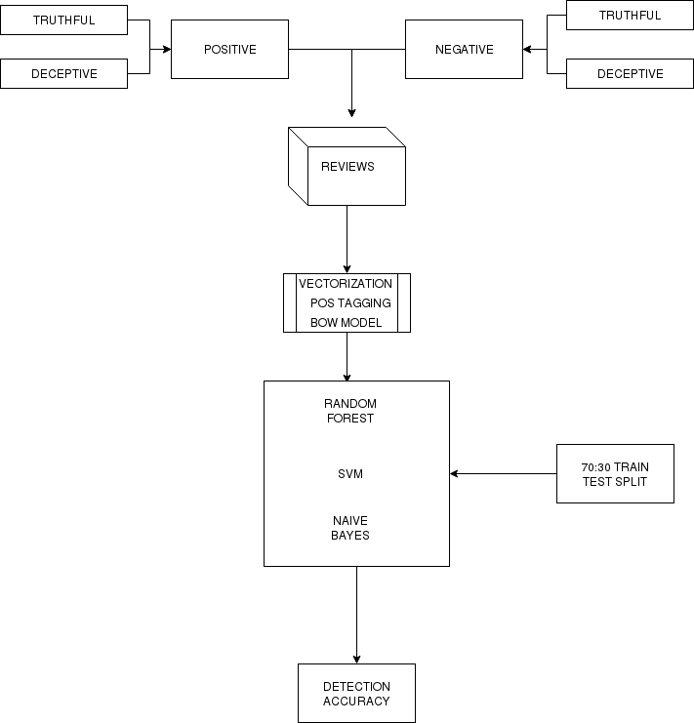

Slide 18
Data
Aggregate text files into positive and negative reviews
cd negative_polarity && find . -type f -print0 | xargs -0 -I file mv --backup=numbered file . && rm -rf truthful_from_Web && rm -rf deceptive_from_MTurk
cd positive_polarity && find . -type f -print0 | xargs -0 -I file mv --backup=numbered file . && rm -rf truthful_from_TripAdvisor && rm -rf deceptive_from_MTurk
Create a data frame

Slide 19
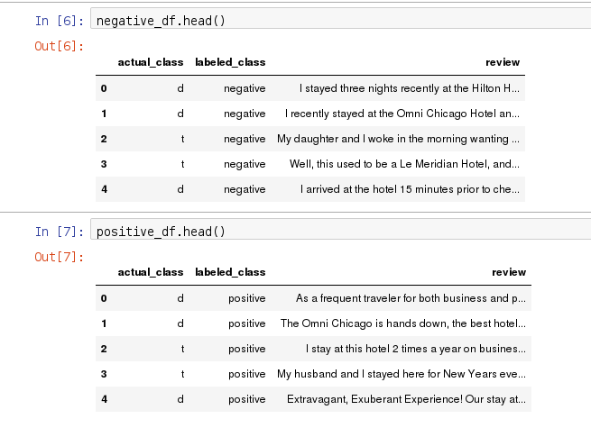

Slide 20
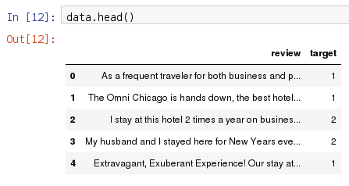

Slide 21
Data Manipulation
Convert the reviews into lower case.
Tag parts of speech of each word and lemmatize the words (reduce the word to root as in dictionary format).
Gensim is used to deal with the semantics
corpara.Dictonary creates a corpus of review_tokenised column
then we create a bag of words model of this corpus
and condense the corpus to sparse form

Slide 22

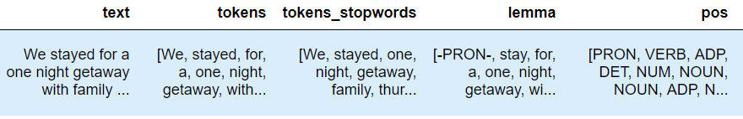
Tokenizing
Sentence Tokens Parts of Speech

Slide 23
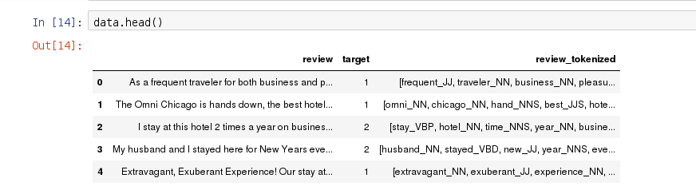

Slide 24
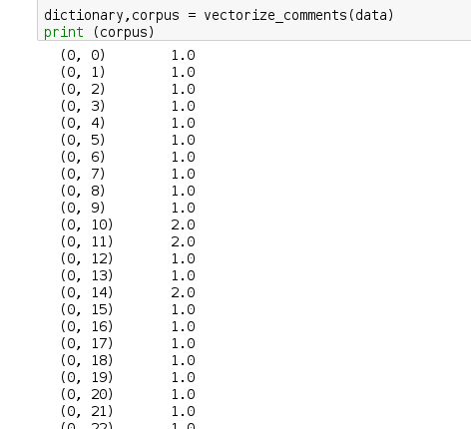

Slide 25
Classification
Random Forest
Support Vector Machine
Multinomial Naive Bayes

Slide 26
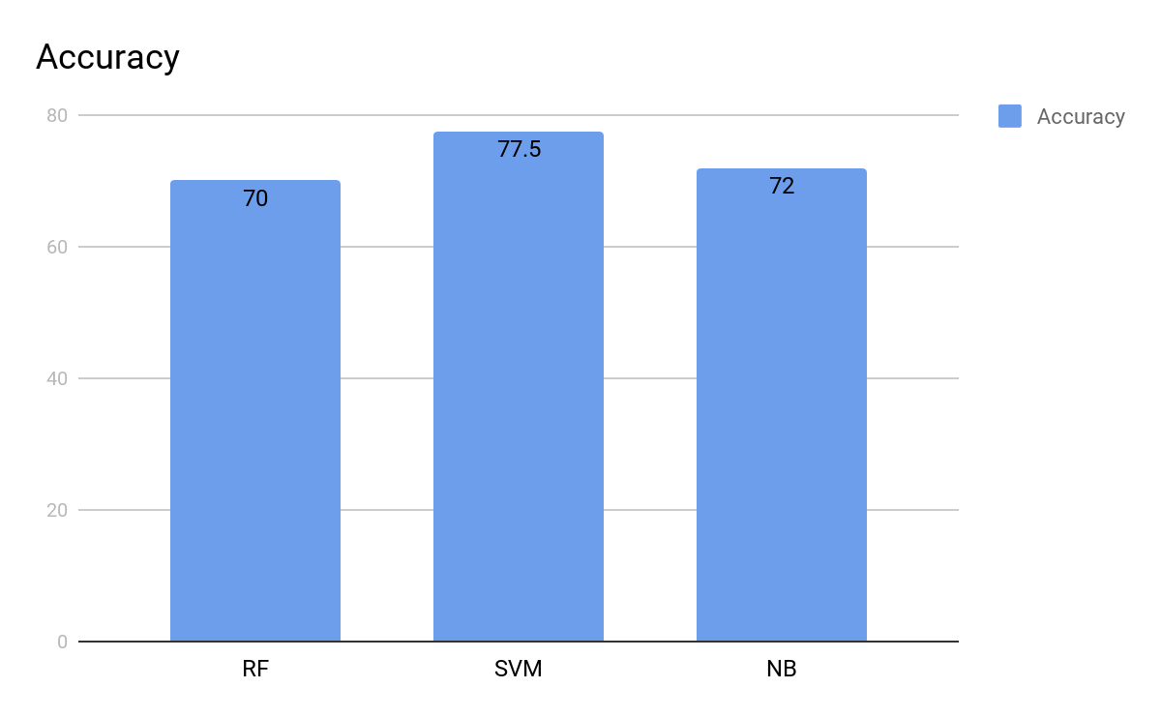
80:20 test train split results

Slide 27
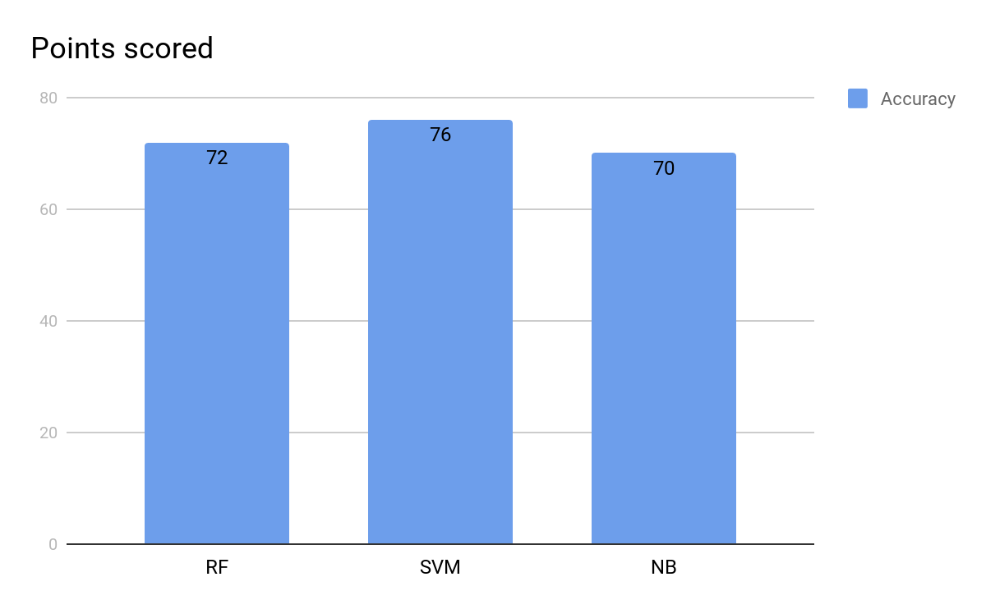
70:30 test train split results

Slide 28
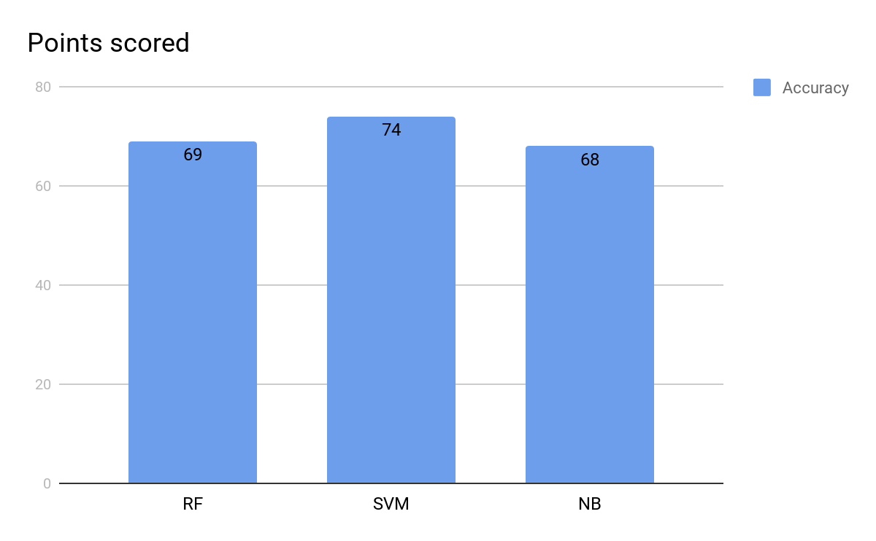
60:40 test train split results

Slide 29
Conclusion
Analysis of classification algorithm over corpus consisting of truthful and deceptive hotel reviews( http://myleott.com/op_spam/).
A comparative study based on unlabelled learning will be implemented
Sentiment analysis of reviews using Naive Bayesian Classifier

